Slide 1
SIMsalabim vs SCAPS

Slide 2
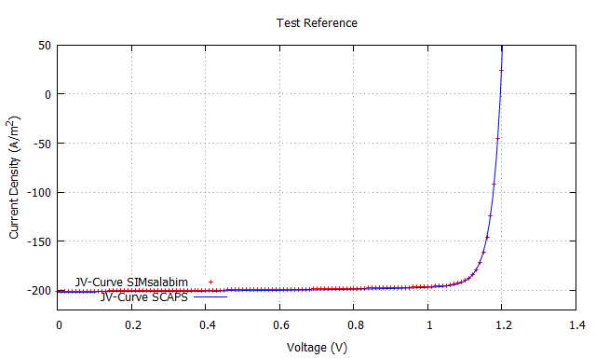
MIM Ref. configuration
Active layer:
Thickness: 300 nm
Bandgap: 1.6 eV
CB (EA): 3.6
Mobility: 1e-4 m²/(Vs)
Kdirect : 1e-18 m³/s
Offset
Contacts:
- aligned to the active layer bands

Slide 3
MIM base configuration
Test number | Thickness (nm) | Electron mobility [m^2/(Vs)] | Hole mobility [m^2/(Vs)] | Kdirect [m^3/s] | Bandgap [eV] | Electrode offset [eV]
Ref | 300 | 1e-4 | 1e-4 | 1e-18 | 1.6 | 0
1 | 300 | 1e-4 | 1e-4 | 1e-17 | 1.6 | 0
2 | 300 | 1e-7 | 1e-7 | 1e-18 | 1.6 | 0
3 | 300 | 1e-4 | 1e-7 | 1e-18 | 1.6 | 0
4 | 100 | 1e-4 | 1e-4 | 1e-18 | 1.6 | 0
5 | 300 | 1e-4 | 1e-4 | 1e-18 | 1.6 | 0.2
6 | 300 | 1e-4 | 1e-4 | 1e-18 | 1.2 | 0

Slide 4
Pin-nip Ref. configuration
Active layer:
Thickness: 300 nm
Bandgap: 1.6 eV
CB (EA): 3.6
Mobility: 1e-4 m²/(Vs)
Kdirect : 1e-18 m³/s
Blocking barrier
Hole transport layer:
Thickness: 20 nm
Bandgap: 1.8 eV
CB (EA): 3.4
Mobility: 1e-4 m²/(Vs)
Kdirect : 0 m³/s
Electron transport layer:
Thickness: 20 nm
Bandgap: 1.8 eV
CB (EA): 3.6
Mobility: 1e-4 m²/(Vs)
Kdirect : 0 m³/s
Contacts:
- aligned to the active layer bands

Slide 5
Test number | ETL HTL Thickness (nm) | Electron mobility [m^2/(Vs)] | Hole mobility [m^2/(Vs)] | Effective density of states [m^-3]
Ref | 20 | 1e-4 | 1e-4 | 1e24
1 | 20 | 1e-7 | 1e-7 | 1e24
2 | 50 | 1e-7 | 1e-7 | 1e24
3 | 20 | 1e-4 | 1e-4 | 1e26
4 | 20 | 1e-7 | 1e-7 | 1e26
5 | 50 | 1e-7 | 1e-7 | 1e26

Slide 6
Pin-nip with traps
Traps/defect:
Bulk_tr: 1e22
Cn = Cp : 1e-13
Etrap 🡪 put it mid gap
Q_charge: 0
Active layer:
Thickness: 300 nm
Bandgap: 1.6 eV
CB (EA): 3.6
Mobility: 1e-4 m²/(Vs)
Kdirect : 1e-18 m³/s
Nc: 1e24 m^-3
Blocking barrier
Hole transport layer:
Thickness: 20 nm
Bandgap: 1.8 eV
CB (EA): 3.4
Mobility: 1e-4 m²/(Vs)
Kdirect : 0 m³/s
Nc: 1e24 m^-3
Electron transport layer:
Thickness: 20 nm
Bandgap: 1.8 eV
CB (EA): 3.6
Mobility: 1e-4 m²/(Vs)
Kdirect : 0 m³/s
Nc: 1e24 m^-3
Contacts:
- aligned to the active layer bands

Slide 7
Test number | Bulk_tr [m^-3] | Cn [m^3/s] | Cp [m^3/s] | Q_charge | Etrap
Ref | 1e21 | 1e-13 | 1e-13 | 0 | Mid-gap
1 | 1e20 | 1e-13 | 1e-13 | 0 | Mid-gap
2 | 1e21 | 1e-13 | 1e-13 | 1 | Mid-gap
3 | 1e20 | 1e-13 | 1e-13 | 1 | Mid-gap
4 | -1e21 | 1e-13 | 1e-13 | 1 | Mid-gap
5 | -1e21 | 1e-12 | 1e-12 | 1 | Mid-gap
6 | -1e20 | 1e-13 | 1e-13 | 1 | Mid-gap
7 | -1e21 | 1e-13 | 1e-13 | 1 | 0.1 below Ec
8 | -1e21 | 1e-13 | 1e-13 | 1 | 0.3 below Ec
9 | -1e21 | 1e-13 | 1e-13 | 1 | 0.1 above EV
10 | -1e22 | 1e-13 | 1e-13 | 1 | 0.1 above EV
11 | 1e22 | 1e-13 | 1e-13 | 1 | 0.1 above EV

Slide 8
Pin-nip with Interface traps
Interface Traps/defect:
St_L and St_R: 1e22
Cn = Cp : 1e-13
Etrap : put it mid gap
Q_charge: 0
Active layer:
Thickness: 300 nm
Bandgap: 1.6 eV
CB (EA): 3.6
Mobility: 1e-4 m²/(Vs)
Kdirect : 1e-18 m³/s
Nc: 1e24 m^-3
Blocking barrier
Hole transport layer:
Thickness: 20 nm
Bandgap: 1.8 eV
CB (EA): 3.4
Mobility: 1e-4 m²/(Vs)
Kdirect : 0 m³/s
Nc: 1e24 m^-3
Electron transport layer:
Thickness: 20 nm
Bandgap: 1.8 eV
CB (EA): 3.6
Mobility: 1e-4 m²/(Vs)
Kdirect : 0 m³/s
Nc: 1e24 m^-3
Contacts:
- aligned to the active layer bands

Slide 9
Test number | St_L [m^-3] | St_R [m^3/s] | Cn = Cp [m^3/s] | Q_charge | Etrap | Nc HTL and ETL
Ref | -1e14 | 1e14 | 1e-13 | 0 | Mid-gap | 1e24
1 | 1e13 | 1e13 | 1e-13 | 0 | Mid-gap | 1e24
2 | -1e14 | 1e14 | 1e-13 | 1 | Mid-gap | 1e24
3 | -1e14 | 1e12 | 1e-13 | 1 | Mid-gap | 1e24
4 | 1e14 | 1e14 | 1e-13 | 1 | Mid-gap | 1e24
5 | -1e14 | 1e14 | 1e-12 | 1 | Mid-gap | 1e24
6 | 1e14 | -1e14 | 1e-13 | 1 | Mid-gap | 1e24
7 | -1e14 | 1e14 | 1e-13 | 1 | 0.1 below Ec | 1e24
8 | -1e14 | 1e14 | 1e-13 | 1 | 0.3 below Ec | 1e24
9 | -1e14 | 1e14 | 1e-13 | 1 | 0.1 above EV | 1e24
10 | -1e14 | 1e14 | 1e-13 | 0 | Mid-gap | 1e26
11 | 1e13 | -1e13 | 1e-13 | 0 | Mid-gap | 1e26

